Slide 1


Mask-wearing in Spain during the COVID-19 outbreak

Slide 2
Voluntary Adoption of Social Welfare-enhancing Behavior
Mask-wearing in Spain during the COVID-19 outbreak

Slide 3
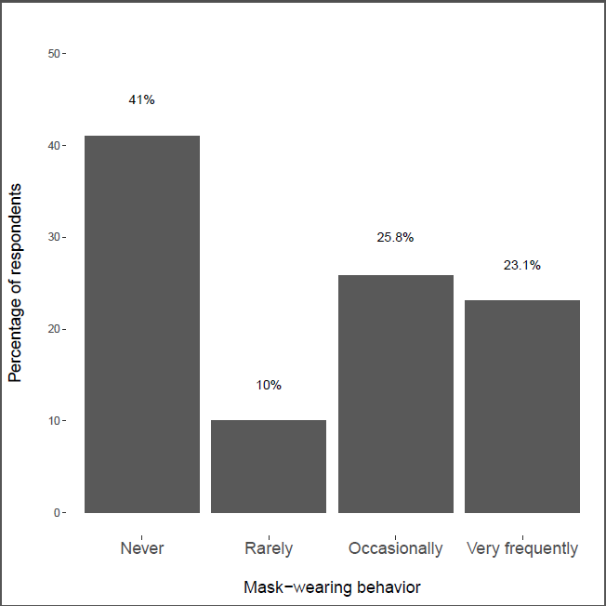
Original Paper findings
The study tries to understanding the social behavior of people in Spain during the COVID-19 in terms of mask wearing as way of containing and controlling the spread of the disease.
41 % of the respondents never wear mask
10% of the respondents rarely wear mask
25.8% occasionally wear mask and
23. 1% very frequently wear mask

Slide 4
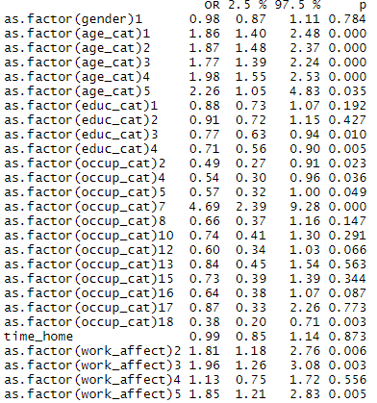
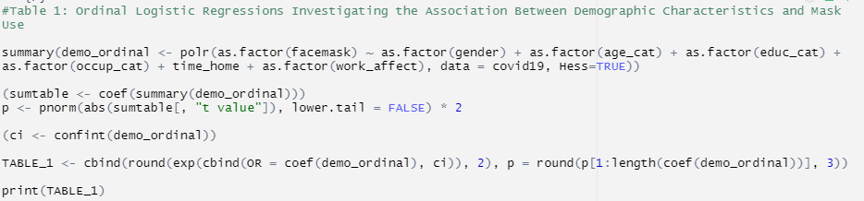
Original findings (Ordinal Logistic Regressions)
The model is used to determine the relationship between Demographic Characteristics and Mask use.
The Demographic variables used are gender , age_cat , educ_cat, occup_cat, time_home and work_affect
Age category affect the mask use
There associated P-values are < 0.05 significance level

Slide 5
Replication
To determine the most predictive demographic factors contribution to mask wearing during cavid-19 outbreak in Spain using OLS regression model
The main research question is: Which are the demographic factors which contributes most to mask wearing during the covid-19 pandemic using non-factor variables.
Hypothesis:
Null hypothesis: The model with factors independent variables fits the data well
Alternative hypothesis: The model with non-factor independent variables fits the data well

Slide 6
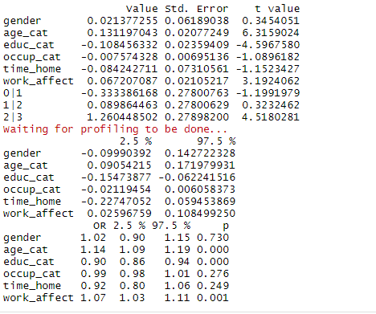
OLS Regression model
The build model is as shown below.

Slide 7
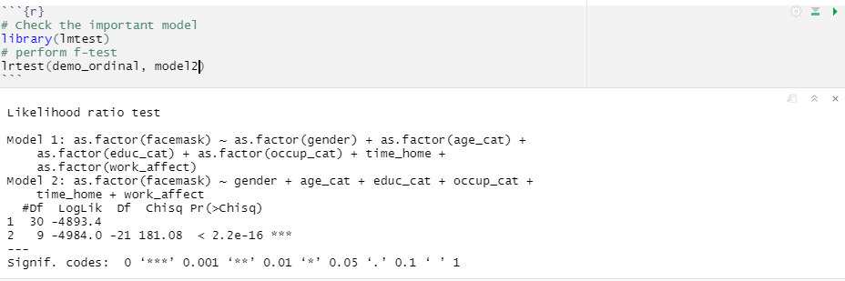
F-test
The F-test was conducted to determine the model which fits the data well between the OLS model using factor predictor variables and non-factor predictor variables
The second model which uses non factor predictor variables is better than the first model

Slide 8
Conclusion
Among the demographic factors: Age, education category and work effect have significant effect on the mask wearing
A unit increase in age lead to 1.14 units increase in mask wearing on average
A unit increase in education category and work effect leads to 0.90 and 1.07 units increase in mask wearing on average.
From the F-test it can be concluded model using non factor predictors fits the data well than the model using factor predictor variables and hence we reject the null hypothesis and accept the alternative hypothesis that the model with non-factor independent variables fits the data well to the data

